Slide 1

DC Crime
at a
Glance
Presented by:
Ana Robles
Dominique Hinton
Fredrica Stanley
Nomin Batjargal

Slide 2


Crimes are a common social problem affecting the quality of life and the economic growth of a society.
Introduction
By providing a data mining approach, we hope to predict the most criminal hotspots by using the type, location and time of previously committed crimes
Does increasing police patrol in high crime areas deter/reduce future crime?....
What police shifts have the highest crime rates?....
Do security cameras reduce crime?
Can future crime be predicted using crime type, location, and time?
What can common citizens can do to prevent being a victim of DC top crime offenses?

Slide 3
Data Collection
Machine Learning Data
Data Source:
www.mpdc.dc.gov.
ETL: Transformed by dropping N/A’s. Determined location of crime(District) would be our x variable
Cleaned Data: Using Jupyter Notebook
Attempt to predict crimes by location and offense.
Crime Analysis Data
Data Source:
Kaggle
www.opendata.dc.gov
ETL: Data was stored and called from Postgres. It provided the DC Metro crime data 2020 and 2021.
Cleaned Data: Imported data into Jupyter Notebook and dropped null values and remove unwanted columns using python pandas.

Slide 4
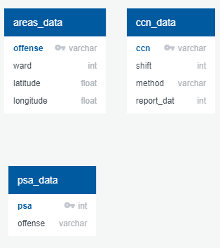
Data
Analysis
Jupyter Notebook to clean data
Postgres to import, join, and create new tables.
Tableau to visualize data:
https://public.tableau.com/views/DCMetroCrimeFinal/VolumeofCrimeperPSA?:language=en-US&publish=yes&:display_count=n&:origin=viz_share_link
Changed ‘Region’ column from numeric (1-5) to North and South. Regions 2,3,4,5 are NORTH and Regions 1,6,7 are SOUTH.
This change assisted in a more accurate prediction in our Logistic Regression model
Notes:
While analyzing the data we noticed:
that time (not necessarily the day, but the time during the day) is one of the more significant factors[this was the visualization and we need to see for our prediction and modeling].
We saw this in the SHIFT variable (which gives the Police duty shift that responded to the call).
When we broke the time down into individual hours of the day, we saw a pronounced cyclic effect, where night-time crimes were far more likely than daytime

Slide 5

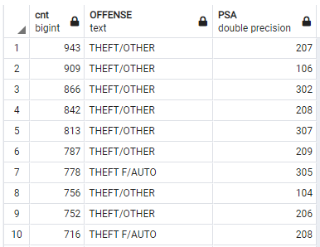
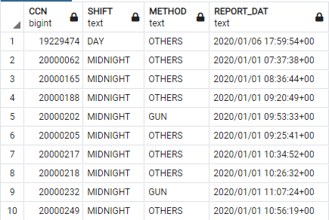
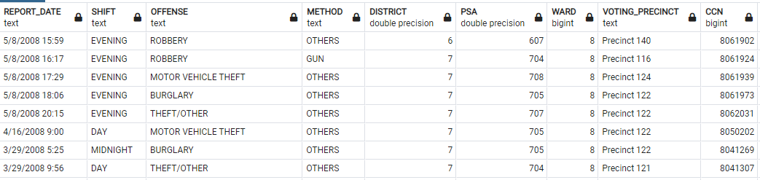
Database Tables (PostGres)

Slide 6
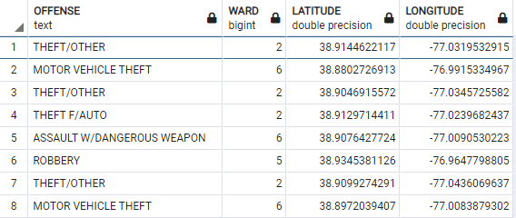
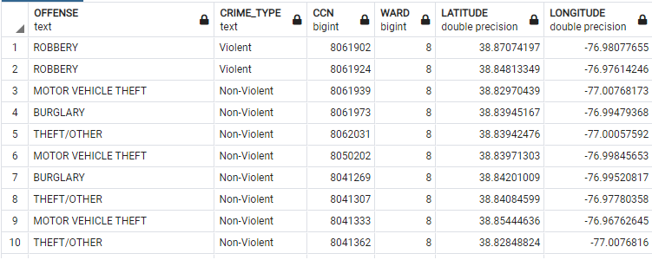
Database Tables (PostGres)

Slide 7
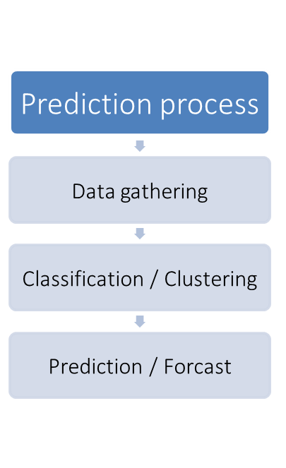
Technologies Used:
Machine Learning
Linear Regression
Logistic Regression
Python Pandas
Matplotlib
Postgres
Tableau

Slide 8
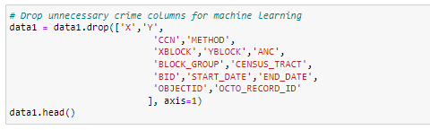
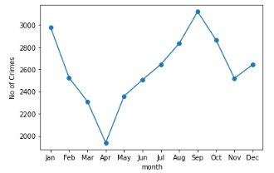
Data Pre-Processing
There were many duplicates, null values, and redundant columns. Also columns like, X, Y coordinates, XBLOCK, YBLOCK, BID, ObjectID, etc which were not relevant for predictions and clustering so we dropped them.
We performed various visualizations using grouping techniques
Grouped data by PSA, District, and Ward.
All produced different trends
This tells us that location affects crime. But how?
One problem with this data is that the victim profile data is missing so we can not incorporate age or gender into the models.
The explanatory variables for this dataset focus on time and locations.
Notes:
Weekend crimes were slightly more likely than crimes during the work week[visualization by week ], and monthly trends appeared to be opposite intuition (fall crimes were more likely than winter or summer crimes)

Slide 9
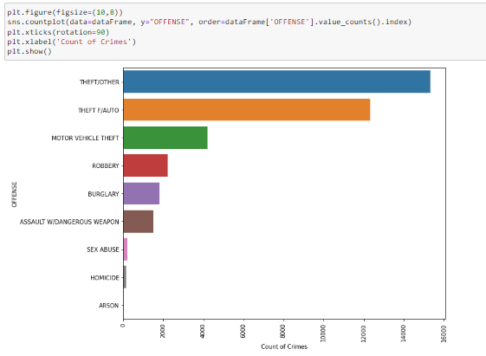
Top Crime Types in DC Metro Area
Crime Type
Arson
Sex Abuse
Homicide
Burglary
Assault w/Dangerous Weapon
Robbery
Motor Vehicle Theft
Theft F/ Auto
Theft/Other

Slide 10
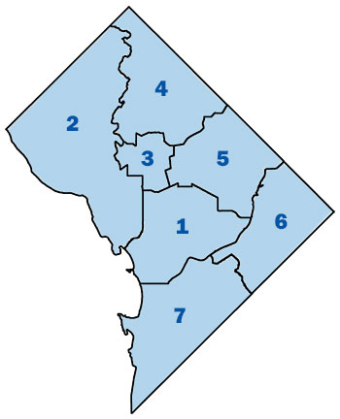
DC Metro
Crime by
Police
District
Visualizing crime method used per District

Slide 11
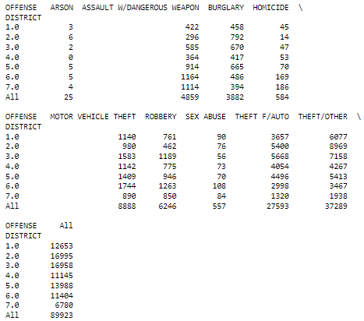
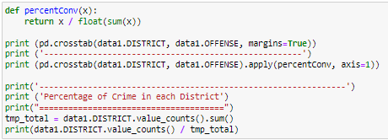
Count of Crime(by Offense) per District
Using Cross Tabulation we can determine that District 2 and District 3 have the most crime of all 8 police districts.
District 7 appears to be the safest district….
Notes:
The count of Crime by offense is broken down by the District (1,2,3,4,5,6,7)
This shows the types of crimes that are likely to be committed in certain Police Districts
Theft appears to be the most common crime committed amongst all 7 districts, however District 7 has the lowest theft rate while District 1 has the highest. Note: The White House and the US Capital are both located in District 1
Of all districts, District 2 and District 3 are almost neck and neck for the highest total crime count.

Slide 12
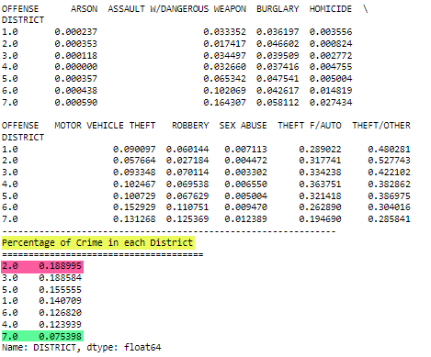
Percentage of Crime(by Offense) in each District
District 2 and District 3 are neck and neck to be the most dangerous district….
District 7 appears to be the safest district….
Notes:
The count of Crime by offense is broken down by the District (1,2,3,4,5,6,7)
This could be used to help determine which districts need a higher police presence.
District 2 has the highest percentage of crime where District 7 has the lowest.
Based on the above crosstabulation of Offense by Police District(PSA) and percentage of crime in each district shows that district 7(0.07) is the safest by a factor of 0.118 compared to the unsafest district 1(0.18).

Slide 13
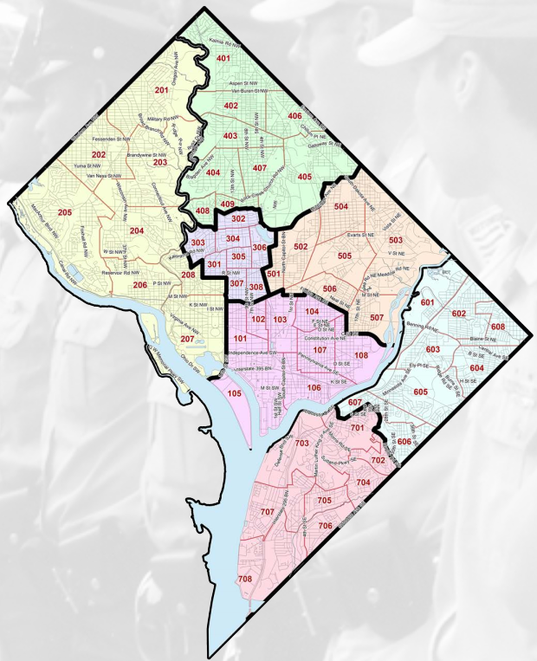
DC Metro
Police Service Area(PSA)
DC Metro Police Service Areas
Notes:
Location appeared to have some influence on crime, but the way the locations were grouped altered the effect significantly.
Using location of the crimes we are hoping to assist MPD with predicting crime in certain Police Service Areas

Slide 14
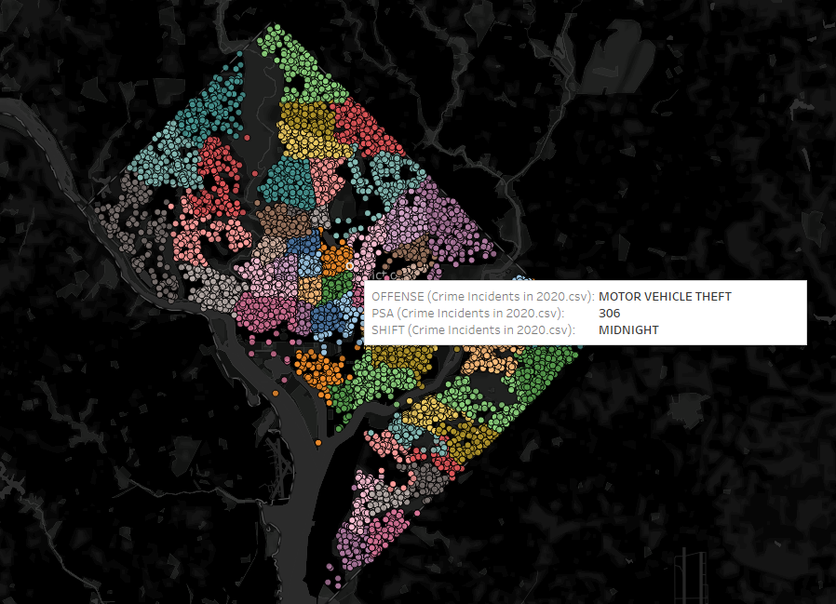
DC Metro
Crime Map per Police Service Area(PSA)
Click here to view interactive map
Notes:
This plot map shows all crimes broken down by Police Service Area(PSA).
There are a total of 57 Police Service Areas

Slide 15
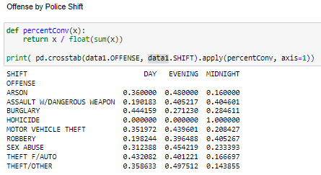
Percentage of Crime per Police Shift
Most crimes are committed during the Evening shift.
Notes:
The Percentage of Crime per offense is broken down into Shifts - Day, Evening, Midnight
This could be used to predict the time of day a crime is most likely to be committed.
For example, a burglary is more likely to occur during daytime hours instead of Evening or Midnight like most would assume.

Slide 16
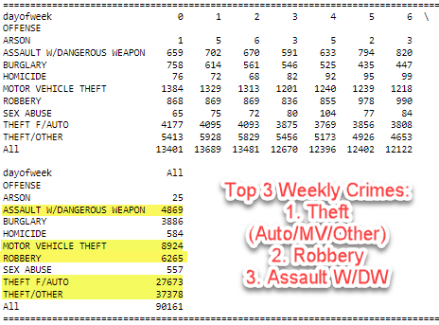
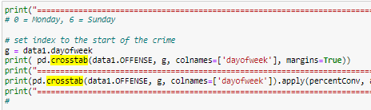
Crime by the Days of the Week
Lock your doors.
Hide your valuables….
You are more likely to be a victim of theft than any other crime in DC
Notes:
The Percentage of Crime per offense is broken down by the Day of the week.
0 = Monday
1 = Tuesday
2 = Wednesday
3 = Thursday
4 = Friday
5 = Saturday
6 = Sunday
This could be used to predict the day of the week a crime is most likely to be committed.
With this knowledge, MPD can brainstorm on preventative measures to incorporate to deter crime in the future
For example, a burglary is more likely to occur during daytime hours instead of Evening or Midnight like most would assume. In this case, we can increase patrol in areas that have high rates of burglary during the Day Shift.
Also, we can inform the public of the data to encourage they lock their doors and don’t leave items in their cars to prevent breakin/theft.

Slide 17
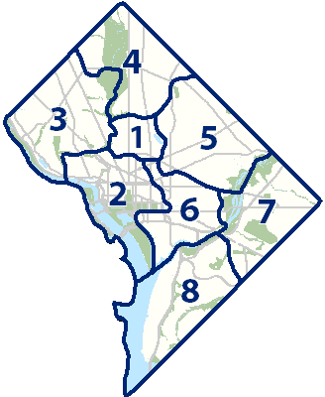
Crimes
per
Ward
Notes:
Crimes per Ward - DC has 8 Wards
Different political areas (Wards and the subordinate Association Neighborhood Committees (ANC)) showed a different trend than using global locations (Latitude and Longitude).
Police districts (and their subordinate Police Service Areas(PSA) showed a different trend than the Ward grouping.

Slide 18
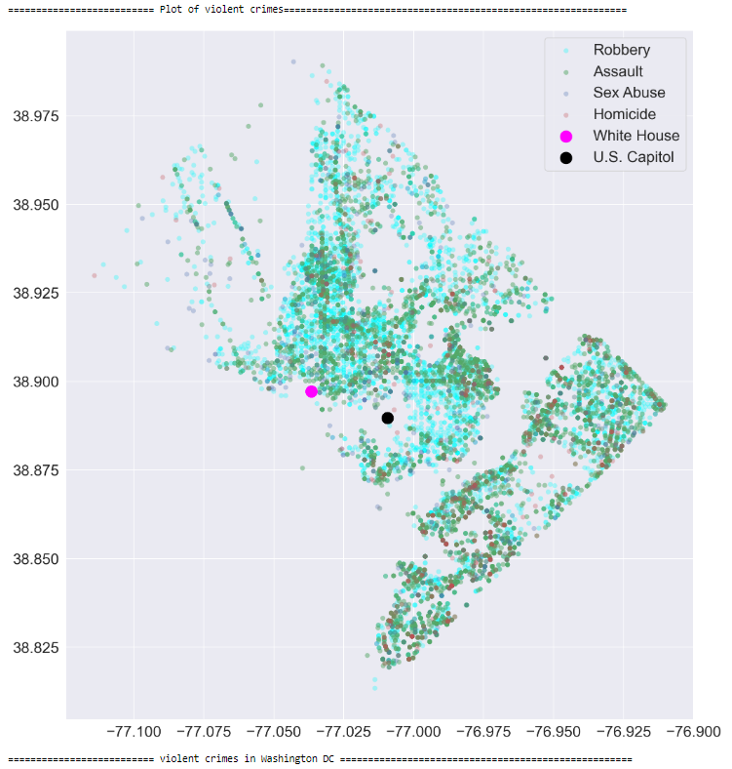
Plot
of
Violent Crimes
The top violent crimes show significance around the business areas of the district, near the white house and all around the Georgia Avenue and towards the North East side of DC.
Notes:
This plot graph shows the correlation of Violent Crimes (Robbery, Assault, Sex Abuse, and Homicide) in correlation to the White House (pink dot on graph) and U.S. Capital(black dot on graph)

Slide 19
MACHINE LEARNING MODEL
Many organizations are continuously researching machine learning and artificial intelligence methods that can help in detecting and preventing crimes. Across the globe, artificial intelligence, and machine learning have helped intelligence services, security departments, and government to improve their security. Then, why not prevent and predict crime?
Pattern Identification
To have a better response towards criminal activity, it is very important that one should understand the patterns in crime.
03
Data Collection
The dataset that is used is collected from the DC Metro Opendata Website (www.opendate.dc.gov)
Prediction
We plan to identify the crime trends and patterns and predict what type of crime may occur in a specific locality of longitude and latitude in a specific schedule of time and season.
01
02
Notes:
Machine learning is used across many industries and we believe that it can be a powerful tool in analyzing and predicting crime and crime trends

Slide 20
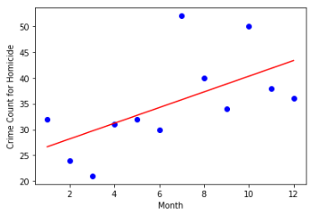
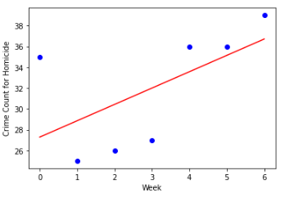
Linear Regression and Homicide
We used Linear Regression to determine whether the month and day of the week can predict a Homicide.

Slide 21
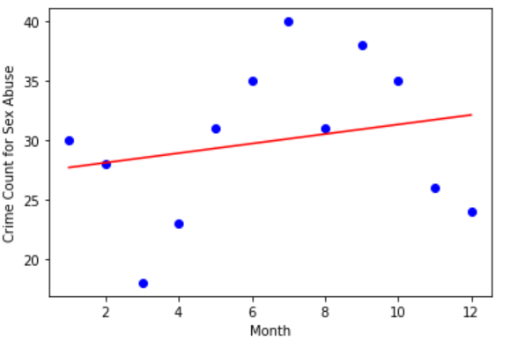
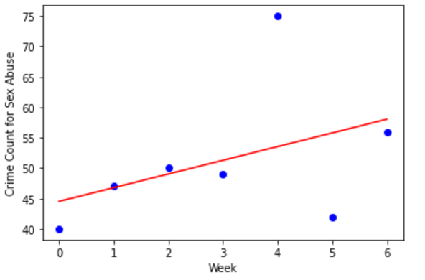
Linear Regression and Sex Abuse
We used Linear Regression to determine whether the month and week of the year can predict Sex Abuse.
Notes:
Weekend crimes were slightly more likely than crimes during the work week[visualization by week ], and monthly trends appeared to be opposite intuition (fall crimes were more likely than winter or summer crimes).

Slide 22
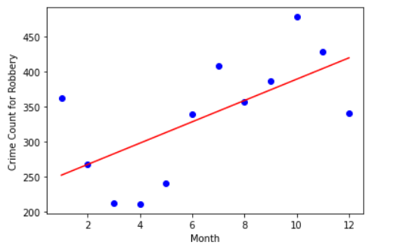
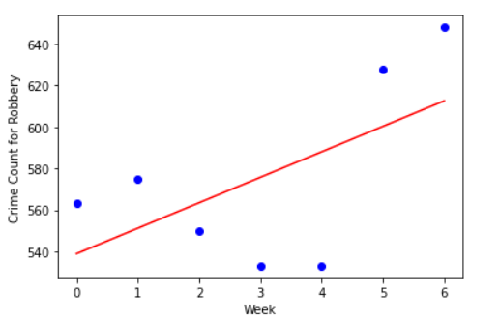
Linear Regression and Robbery
We used Linear Regression to determine whether the month and week of the year can predict a Robbery.
Notes:
Weekend crimes were slightly more likely than crimes during the work week[visualization by week ], and monthly trends appeared to be opposite intuition (fall crimes were more likely than winter or summer crimes).

Slide 23
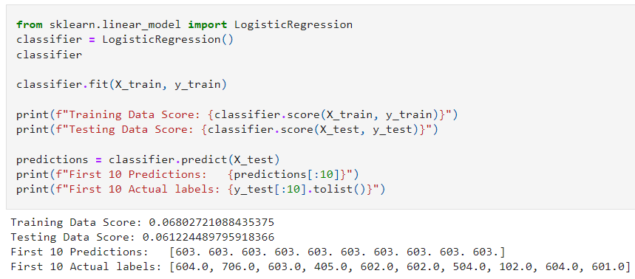
Logistic Regression – First Attempt (Fail)
Predicts the Police Service Area a Homicide is more likely to be committed.
There are a total of 57 PSA
Prediction Result:
PSA 603
PSA 604
PSA 706
PSA 405
PSA 602
PSA 504
PSA 102
PSA 601

Slide 24
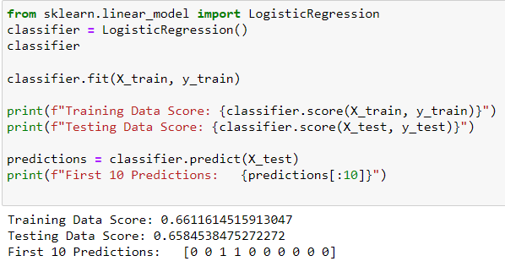
Logistic Regression - Second Attempt (Success)
Predicts the region where the crime was committed
Police Districts divided into two regions:
North
South
Training Data Score: 66.1%
Testing Data Score: 65.8%
Notes:
Split the 7 police districts into regions: North and South
Examine the association of method, offense, and police shift on target variable of region - north or south.

Slide 25
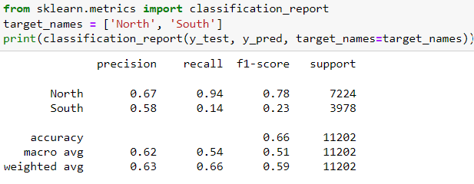
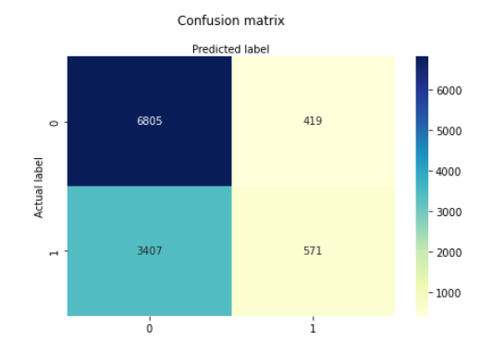
Logistic Regression
Higher accuracy in predicting crime in Northern Region of DC,
Precision 67% & Sensitivity 94% for North Region
Precision 58% & Sensitivity 14% for South Region

Slide 26
Findings & Recommendations for Future Analysis
Problems w/dataset:
No age, gender, or ethnicity information provided.
We believe that the detection/classification of a Violent crime would be heavily based on the victim's characteristics, and not exclusively on the location or time.
RECOMMENDATION: Include age, gender, and ethnicity data to provide more accurate/specific predictions
Approximately 83% of the 46000+ crime reports are nonviolent
This resulted in a very imbalanced classification when using violent vs nonviolent variables
RECOMMENDATION: Use more specific data such as Crime Offense or location of crime.
Theft is the most common crime committed in the DC Metro area.
Logistic Regression Findings:
First Attempt:
Determined that there are too many PSAs (57) to get an accurate prediction.
This resulted in a very low testing score (0.068)and training score(0.061).
This is not a good model
Second Attempt:
Used Police Districts to create a more reliable model.
Condensed 7 Districts into two regions.
NOrth Region = Districts 2,3,4,5
South Region = Districts 1,6,7
This resulted in higher accuracy of prediction

Slide 27
Questions?
Presented by:
Ana Robles
Dominique Hinton
Fredrica Stanley
Nomin Batjargal

